Slide 1
AUTOMATIC PARKING COUNTER
"Navigating the Future of Parking Management"

Slide 2
TABLE OF CONTENTS
01
02
03
04
INTRODUCTION
THE PROBLEM
A Project Introduction with its Real life Problem
The current issue with parking systems.
OUR SOLUTION
COMPONENTS USED
Our solution and prototype to solve the parking problem
Different Components required to Build these Project

Slide 3
TABLE OF CONTENTS
05
06
07
08
SOFTWARE LAYOUT
PROJECT DESIGN
A Conceptual explanation of Project Idea
Systematic Design to
Handle different situation
FUTURE ENHANCEMENTS
CONCLUSION
Ideas to Enhance and Develop the current Project to its pros
Concluding the Project How useful its was.

Slide 4
01
INTRODUCTION
"Join Us on a Journey to Effortless Parking“

Slide 5
INTRODUCTION
Imagine a world where finding a parking space is no longer a hassle, where parking lots are efficiently managed, and drivers experience a seamless entry and exit process.
Our project aims to bring this vision to life by introducing a state-of-the-art solution that combines technology and automation to revolutionize the way we manage parking facilities.

Slide 6
THE PROBLEM
Nowadays, Parking systems are dependent on human intervention or staff-maintained databases.
This leaves room for human error and can lead to mismanagement and chaos in the parking lot.
The overestimation of available parking spaces can cause overcrowding, vehicle damage or unnecessary conflict.

Slide 7
OUR SOLUTION

Slide 8
COMPONENTS USED
04
"Powering Efficiency, One Component at a Time"

Slide 9
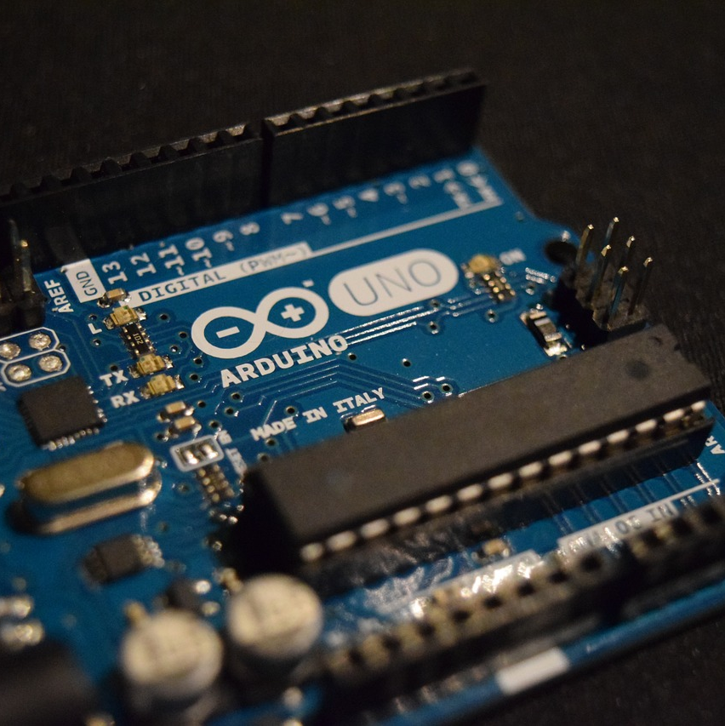
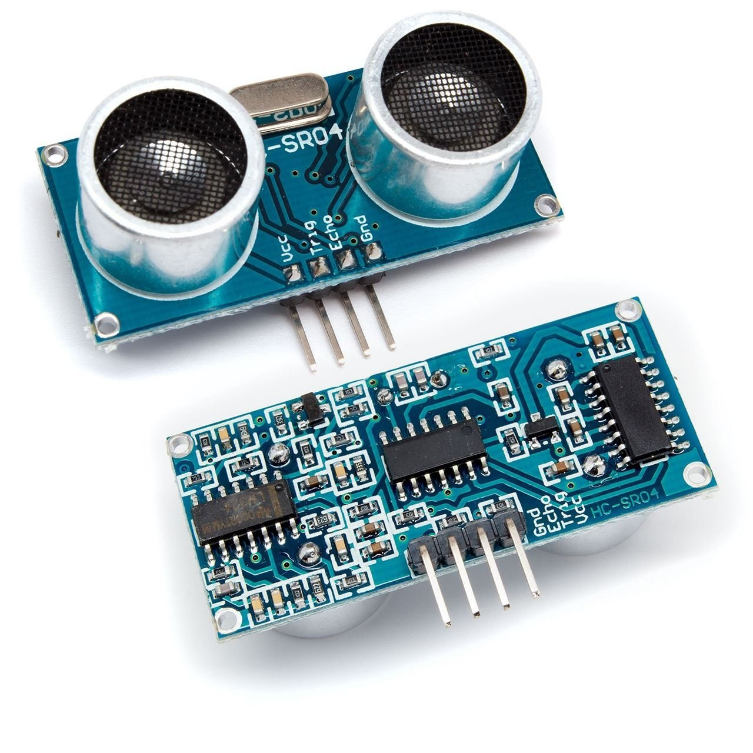
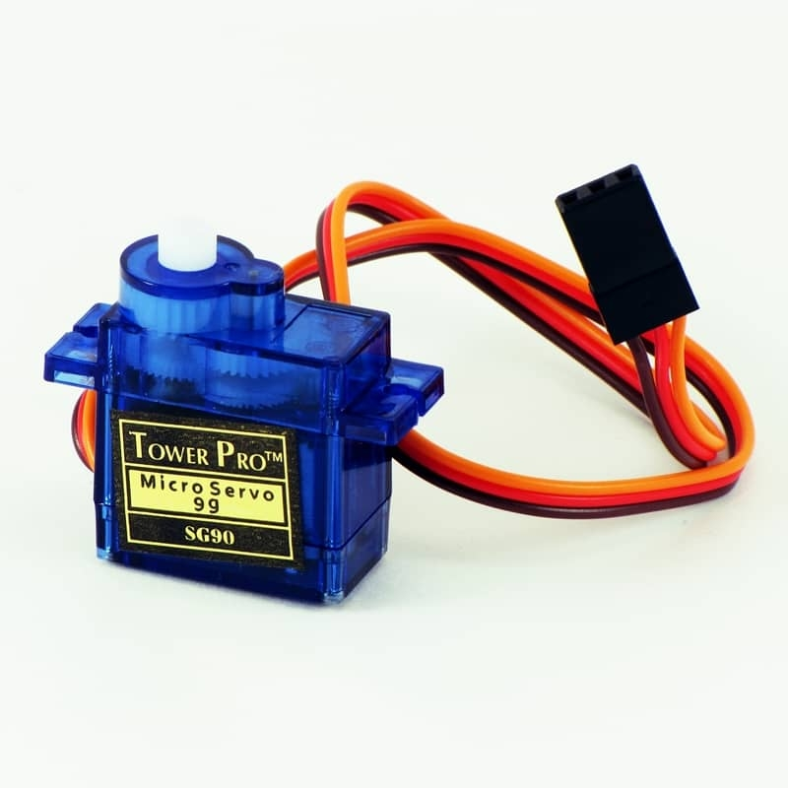
COMPONENTS USED
ARDUINO UNO
HC-SR04
SERVO MOTOR
A
Microcontroller Board
A
Ultrasonic Sensor Module
An Angular Positioning Motor

Slide 10
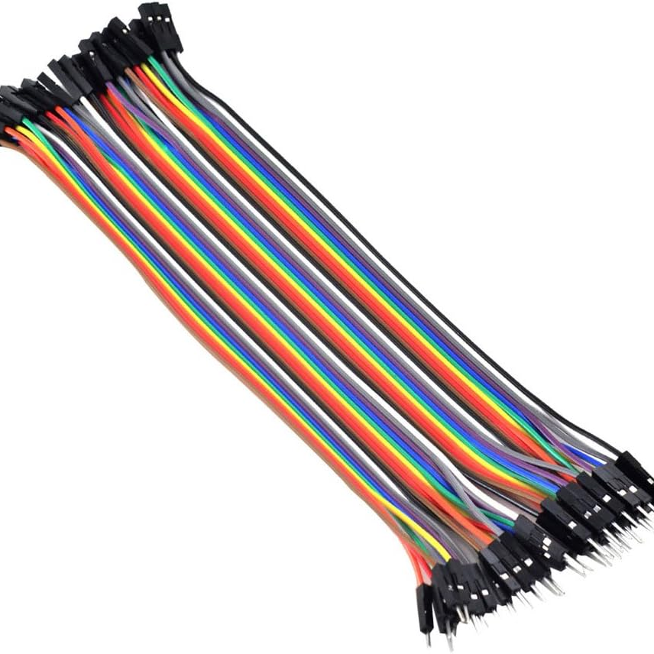
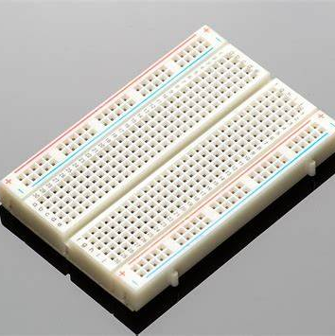
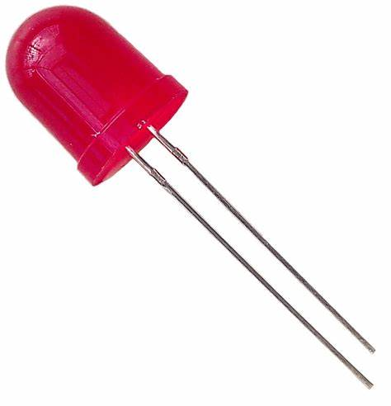
COMPONENTS USED
JUMPER WIRE
BREAD BOARD
LED
A Connecting Wire
A Prototyping Board
A Light Indicator

Slide 11
PROJECT DESIGN
05
"Where Innovation Meets Infrastructure"

Slide 12
PROJECT DESIGN
CAR DETECTION
GATE CONTROL
CAR COUNTING
LED INDICATORS
Ultrasonic sensors detect car presence at the front and rear.
The gate opens if the front sensor detects a car and parking slots are available; it closes after a brief delay.
The system tracks car count, incrementing when a car enters and decrementing when it exits.
LEDs represent parking spaces; they light up or turn off as cars enter or exit.

Slide 13
CIRCUIT DIAGRAM

Slide 14
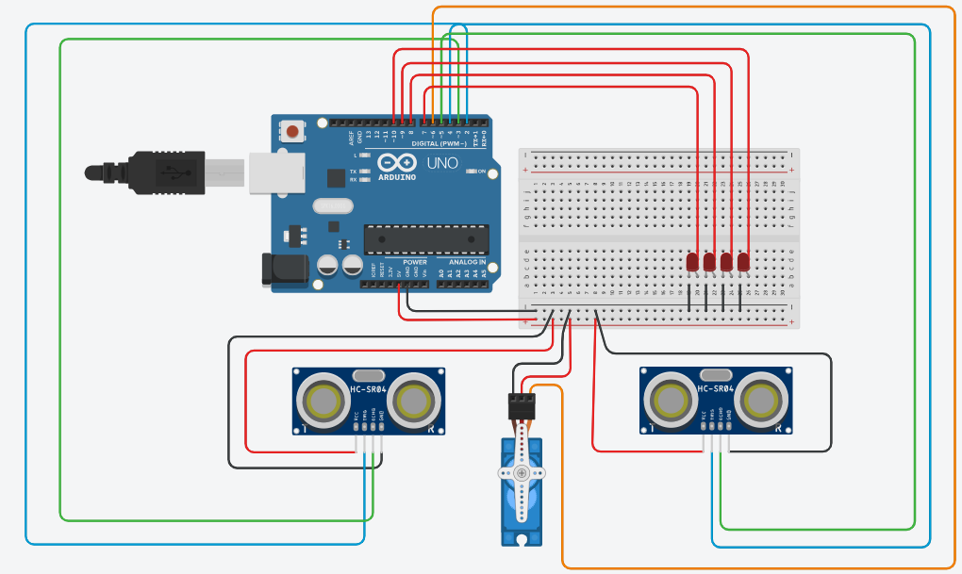

Slide 15
SOFTWARE LAYOUT
06
"Code, Control, and Convenience"

Slide 16
SOFTWARE LAYOUT
#include <Servo.h>
Servo gateServo; // Define a servo object for the gate
const int trigFrontPin = 2;
const int echoFrontPin = 3;
const int trigRearPin = 4;
const int echoRearPin = 5;
const int gateOpenAngle = 90; // Angle to open the gate
const int gateClosedAngle = 0; // Angle to close the gate
const int numberOfSlots = 5;
int availableSlots = numberOfSlots;
const int ledPins[] = {6, 7, 8, 9, 10};
int carCount = 0; // Initialize car count
void setup() {
gateServo.attach(11); // Servo motor control pin
pinMode(trigFrontPin, OUTPUT);
pinMode(echoFrontPin, INPUT);
pinMode(trigRearPin, OUTPUT);
pinMode(echoRearPin, INPUT);}

Slide 17
SOFTWARE LAYOUT
for (int i = 0; i < numberOfSlots; i++) {
pinMode(ledPins[i], OUTPUT);
}
updateLEDs();
Serial.begin(9600);
void loop() {
long frontDistance = measureDistance(trigFrontPin, echoFrontPin);
long rearDistance = measureDistance(trigRearPin, echoRearPin);
// Check if a car is entering from the front
if (frontDistance < 5) {
if (availableSlots > 0) {
openGate();
availableSlots--;
carCount++;
updateLEDs();
delay(2000); // Allow 3 seconds for a car to pass through
closeGate();} }

Slide 18
SOFTWARE LAYOUT
// Check if a car is leaving from the rear
if (rearDistance < 5) {
if (availableSlots > -1){
availableSlots++;
carCount--;
updateLEDs();
openGate();
delay(3000);
closeGate();} // Delay to prevent multiple counts for the same car
}
// Display information on Serial Monitor
Serial.print("Front Distance: ");
Serial.print(frontDistance);
Serial.print(" cm | Rear Distance: ");
Serial.print(rearDistance);
Serial.print(" cm | Available Slots: ");
Serial.print(availableSlots);
Serial.print(" | Car Count: ");
Serial.println(carCount);
}

Slide 19
SOFTWARE LAYOUT
long measureDistance(int trigPin, int echoPin) {
digitalWrite(trigPin, LOW);
delayMicroseconds(2);
digitalWrite(trigPin, HIGH);
delayMicroseconds(10);
digitalWrite(trigPin, LOW); return pulseIn(echoPin, HIGH) / 58.2; // Calculate distance in centimeters
}
void openGate() {
gateServo.write(gateOpenAngle);
}
void closeGate() {
gateServo.write(gateClosedAngle);
}
void updateLEDs()
{// LED control logic based on available slots}
}

Slide 20
FUTURE ENHANCEMENT
07
"Tomorrow's Parking, Today's Innovations"

Slide 21
FUTURE STRATEGY
Predictive Analytics
IoT and Smart Sensors
Integrate data analytics and machine learning to predict parking demand.
Develop algorithms that anticipate peak hours, special events, and holidays to optimize resource allocation.
Embrace IoT by deploying smart sensors throughout the parking area.
Collect data on vehicle types, temperature, and air quality for improved security, comfort.

Slide 22
FUTURE ENHANCEMENT
LICENSE PLATE RECOGONITION
RESERVATION SYSTEM
VEHICLE CLASSIFICATION
INTEGRATE WITH APPS
Recognize log license plates of entering and exiting vehicles.
Enable users to choose preferred parking locations and time slots
Implement sensors and algorithms for classifying vehicles
Real-time notifications about parking space availability and access.

Slide 23
CONCLUSION

Slide 24
THANK YOU!

